Slide 1

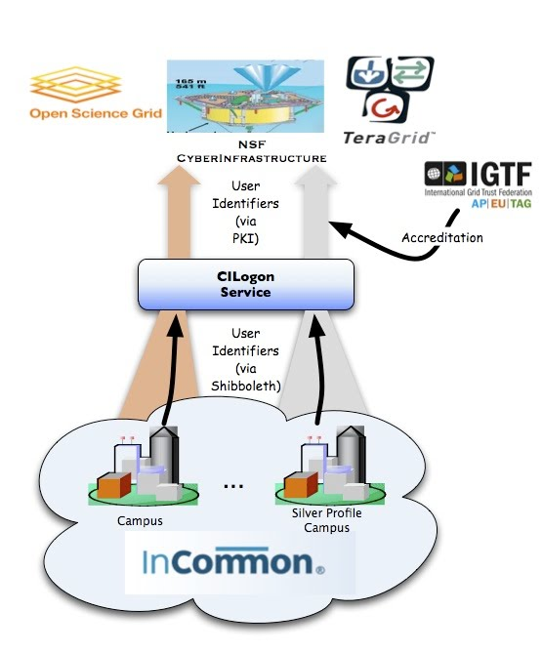
CILogon: Federated Logon to NSF Cyberinfrastructure
https://cilogon.org
The CILogon Project is deploying the open source, standards-based CILogon Service to provide the NSF research community with credentials for secure access to cyberinfrastructure (CI). The service bridges the identity credentials generated by the nation’s universities, through the InCommon Federation, to credentials that satisfy the authentication and authorization needs of NSF’s CI projects.
The primary technical challenge we face is the technology difference between InCommon, which is based on the Security Assertion Markup Language (SAML) as implemented by the Internet2 Shibboleth software, and NSF’s cyberinfrastructure, which is based on public key infrastructures (PKIs) that emerged from computational grids. The CILogon Service will address this challenge by operating an online Certification Authority (CA) to issue certificates on demand based on an InCommon login.
This effort is a follow-on to TeraGrid’s federated logon service (https://go.teragrid.org), deployed in September 2009, which allows TeraGrid researchers to access TeraGrid resources using their campus login, by bridging from InCommon Federation (SAML) to International Grid Trust Federation (PKI) credentials. The CILogon Service will extend this capability beyond TeraGrid to serve all InCommon member researchers. It is scheduled to officially begin operation in September 2010, after a testing period starting in April.
This material is based upon work supported by the National Science Foundation under grant number 0943633. Any opinions, findings, and conclusions or recommendations expressed in this material are those of the author(s) and do not necessarily reflect the views of the National Science Foundation.

